Slide 1

Unit-7: Backtracking and Branch & Bound
Analysis and Design of Algorithms (ADA)
GTU # 3150703
Dr. Gopi Sanghani
Computer Engineering Department
gopi.sanghani@darshan.ac.in
9825621471

Slide 2

Outline
Backtracking
The N - queens problem
Branch & Bound
Knapsack problem
Travelling Salesman problem
Minimax principle
Looping

Slide 3
Backtracking

Slide 4
Introduction
Backtracking can be defined as a general algorithmic technique that considers searching every possible combination in order to solve an optimization problem.
It is a recursive technique.
It generates a state space tree for all possible solutions.
It traverse the state space tree in the depth first order.
So, in a backtracking we attempt solving a sub-problem, and if we don't reach the desired solution, then undo whatever we did for solving that sub-problem, and try solving another sub-problem.
All the solutions require a set of constraints divided into two categories: explicit and implicit constraints.

Slide 5
The N - Queen Problem
The 𝑁 - queen is the problem of placing N chess queens on an 𝑁×𝑁 chessboard so that, no two queens attack each other.
Two queens of same row, same column or the same diagonal can attack each other.
K-Promising solution: A solution is called k-promising if it arranges the k - queens in such a way that, they can not threat each other.
Q
Q
Q
Q
 | Q
1 - Promising Solution
0 - Promising Solution
0 - Promising Solution
0 - Promising Solution

Slide 6
The 4 - Queen Problem
 | 1 | 2 | 3 | 4
 | Q
 | 1 | 2 | 3 | 4
 | Q
 | Q | Q | Q
 | Q | Q | Q | Q
 | 1 | 2 | 3 | 4
 |  |  | Q
 | Q
 | Q | Q | Q | Q
 | Q | Q
1 - Promising
2 - Promising
4 – Promising <3, 1, 4, 2>
 | 1 | 2 | 3 | 4
1 |  | Q
2 |  |  |  | Q
3 | Q
4 |  |  | Q
Above 4-promising solution can be written as <3, 1, 4, 2>
Another possible solution is <2, 4, 1, 3>
4 – Promising <2, 4, 1, 3>

Slide 7
N - Queen Problem
Number of Queens | Possible Solutions
1 | 1
2 | 0
3 | 0
4 | 2
5 | 10
6 | 4
7 | 40
8 | 92
9 | 352
10 | 724

Slide 8
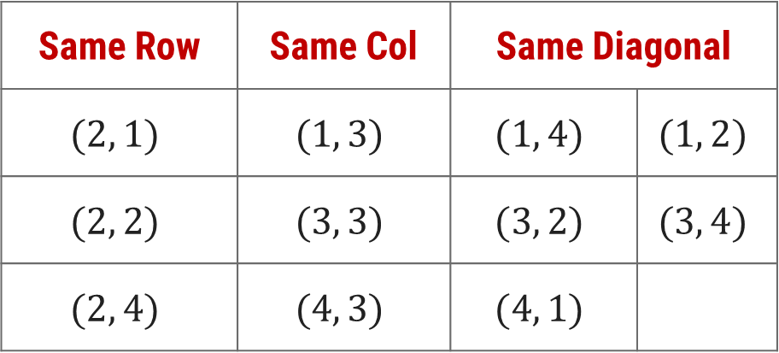



N - Queen Problem Solution
Here, suppose queen position is $(2, 3)$.
To identify the positions that can not be chosen, so that the queen does not attack.
The diagonal positions which are under attack are denoted as,
 | 1 | 2 | 3 | 4
1
2 |  |  | Q
3
4
Same Row | Same Col | Same Diagonal
$$(2, 1)$$ | $$(1, 3)$$ | $$(1, 4)$$ | $$(1, 2)$$
$$(2, 2)$$ | $$(3, 3)$$ | $$(3, 2)$$ | $$(3, 4)$$
$$(2, 4)$$ | $$(4, 3)$$ | $$(4, 1)$$
$$Row−Col$$
$$Row+Col$$

Slide 9
1
 | 1 | 2 | 3 | 4
1 |  | Q
2 |  |  |  | Q
3 | Q
4 |  |  | Q
2
[2,0,0,0]
4
[2,4,0,0]
[2,4,1,0]
Sol =
[2,4,1,3]
K =
3
col =
{2,4}
{2}
diag45 =
{2}
{2,3,-2}
{2,4,1}
{2,3}
diag135 =
{2,5}
{2}
{2,5,4}
procedure queens (k, col, diag45, diag135)
{sol[1..k] is k-promising,
col = {sol[i] | 1≤i≤k},
diag45 = {sol[i]–i+1 | 1≤i≤k}, and
diag135 = {sol[i]+i–1 | 1≤i≤k}}
if k = 4 then
write sol
else
for j ← 1 to 4 do
if j ∉ col and j – k ∉ diag45 and j + k ∉ diag135
then sol[k+1]← j
queens(k + 1, col U {j}, diag45 U {j - k}, diag135 U {j + k})
1- Promising
2- Promising
3- Promising
4- Promising
j + k = 2
j + k = 5
j - k = -1
j + k = 3
j - k = 0
j - k = 2
j = 1
j - k = 3
j = 2
j = 3
j = 4
j = 1

Slide 10
N – Queen Algorithm
sol[1…8] is global array, for all solutions to the eight queens problem call queens (0, ∅, ∅, ∅)
procedure queens (k, col, diag45, diag135)
{sol[1..k] is k-promising,
col = {sol[i] | 1≤i≤k},
diag45 = {sol[i]–i+1 | 1≤i≤k}, and
diag135 = {sol[i]+i–1 | 1≤i≤k}}
if k = 8 then {an 8-promising vector is a solution}
write sol
else {explore (k+1)-promising extensions of sol }
for j ← 1 to 8 do
if j ∉ col and j – k ∉ diag45 and j + k ∉ diag135 ∉ sol[k+1] ← j
then sol[k+1]← j
{sol[1..k+1] is (k+1)-promising}
queens(k + 1, col U {j}, diag45 U {j - k}, diag135 U {j + k})

Slide 11
Branch & Bound

Slide 12
Introduction
The branch & bound approach is based on the principle that the total set of feasible solutions can be partitioned into smaller subsets of solutions.
These smaller subsets can then be evaluated systematically until the best solution is found.
Branch & bound is an algorithm design approach which is generally used for solving combinatorial optimization problems.
These problems are typically exponential in terms of time complexity and may require exploring all possible permutations in worst case.
The Branch & Bound Algorithm technique solves these problems relatively quickly.

Slide 13
0/1 Knapsack Problem – Introduction
Let us consider the 0/1 Knapsack problem to understand Branch & Bound.
The Backtracking Solution can be optimized if we know a bound on best possible solution subtree rooted with every node.
If the best in subtree is worse than current best, we can simply ignore this node and its subtrees.
So, we compute bound (the best solution) for every node and compare the bound with current best solution before exploring the node.
We are given a certain number of objects and a knapsack.
Instead of supposing that we have n objects available, we shall suppose that we have n types of object, and that an adequate number of objects of each type are available.
Our aim is to fill the knapsack in a way that maximizes the value of the included objects.
We may take an object or leave behind, but we may not take fraction of an object.

Slide 14
0/1 Knapsack using Branch & Bound
Initially solution is empty.
Left of the semicolon are weights of selected objects.
Right of the semicolon is the current total value of load.
Weight of objects
w = (2,3,4,5)
Corresponding value of each object
v = (3,5,6,10)
Capacity of Knapsack
W = 8
Now, apply depth first search
; 0
2 ; 3
3 ; 5
4 ; 6
5 ; 10
2,2; 6
2,3; 8
2,4; 9
2,5; 13
3,3; 10
3,4; 11
3,5; 15
4,4; 12
2,2,2; 9
2,2,3; 11
2,2,4; 12
2,3,3; 13
Store solution if optimal solution is found
2,2,2,2; 12

Slide 15
0/1 Knapsack Problem – Algorithm
function backpack(i, r)
{Calculates the value of the best load that can be constructed using items of type i to n and whose total weight does not exceed r}
b ← 0
{Try each allowed kind of item in turn}
for k ← i to n do
if w[k] ≤ r then
b ← max(b, v[k] + backpack (k, r – w[k]))
return b

Slide 16
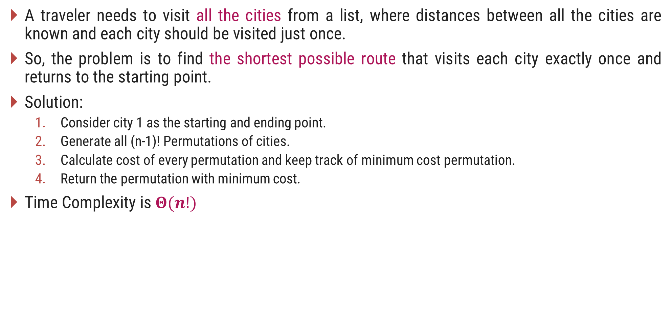
Travelling Salesman Problem (TSP) – Introduction
A traveler needs to visit all the cities from a list, where distances between all the cities are known and each city should be visited just once.
So, the problem is to find the shortest possible route that visits each city exactly once and returns to the starting point.
Solution:
Consider city 1 as the starting and ending point.
Generate all (n-1)! Permutations of cities.
Calculate cost of every permutation and keep track of minimum cost permutation.
Return the permutation with minimum cost.
Time Complexity is $Θ(n!)$

Slide 17
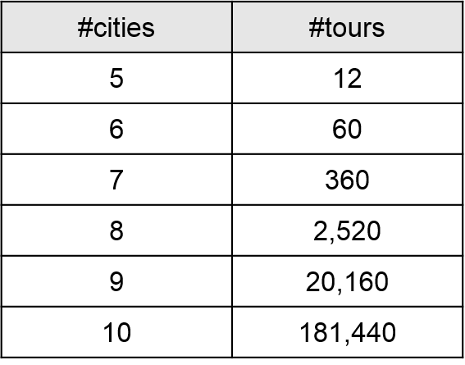
Travelling Salesman Problem (TSP) – Introduction
The number of tours grows exponentially as we add cities to the map,

Slide 18
TSP using Branch & Bound
Here, total minimum distance = sum of row/column minimum = 31
The upper bound = A ⟶B⟶C⟶D⟶E⟶A = 41
Solution : [31…41]
 | A | B | C | D | E
A | -- | 10 | 8 | 9 | 7
B | 10 | -- | 10 | 5 | 6
C | 8 | 10 | -- | 8 | 9
D | 9 | 5 | 8 | -- | 6
E | 7 | 6 | 9 | 6 | --
A
10
B
8
9
10
5
6
7
C
8
D
9
6
E

Slide 19


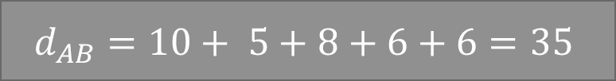


TSP using Branch & Bound
 | A | B | C | D | E
A | -- | 10 | 8 | 9 | 7
B | 10 | -- | 10 | 5 | 6
C | 8 | 10 | -- | 8 | 9
D | 9 | 5 | 8 | -- | 6
E | 7 | 6 | 9 | 6 | --
$$d_{AB}$$
$$d_{AE}$$
$$d_{AC}$$
$$d_{AD}$$
35
 | A | C | D | E
B | -- | 10 | 5 | 6
C | 8 | -- | 8 | 9
D | 9 | 8 | -- | 6
E | 7 | 9 | 6 | --
$$d_{AB}=10+ 5+8+6+6=35$$
Distance from A to B

Slide 20
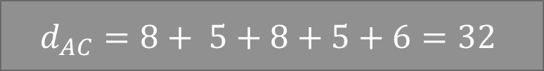
TSP using Branch & Bound
 | A | B | C | D | E
A | -- | 10 | 8 | 9 | 7
B | 10 | -- | 10 | 5 | 6
C | 8 | 10 | -- | 8 | 9
D | 9 | 5 | 8 | -- | 6
E | 7 | 6 | 9 | 6 | --
$$d_{AB}$$
$$d_{AE}$$
$$d_{AC}$$
$$d_{AD}$$
35
32
34
31
 | A | C | D | E
B | 10 | -- | 5 | 6
C | -- | 10 | 8 | 9
D | 9 | 5 | -- | 6
E | 7 | 6 | 6 | --
$$d_{AC}=8+ 5+8+5+6=32$$
Distance from A to C

Slide 21


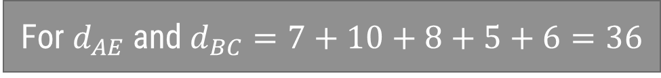

TSP using Branch & Bound
 | A | B | C | D | E
A | -- | 10 | 8 | 9 | 7
B | 10 | -- | 10 | 5 | 6
C | 8 | 10 | -- | 8 | 9
D | 9 | 5 | 8 | -- | 6
E | 7 | 6 | 9 | 6 | --
$$d_{AB}$$
$$d_{AE}$$
$$d_{AC}$$
$$d_{AD}$$
35
32
34
31
$$d_{BA}$$
$$d_{BC}$$
$$d_{BD}$$
36
36
34
 | A | B | D
C | 8 | -- | 8
D | 9 | 5 | --
E | 7 | 6 | 6
For $d_{AE}$ and $d_{BC}=7+10+8+5+6=36$
Distance from A to E
Distance from B to C

Slide 22





TSP using Branch & Bound
 | A | B | C | D | E
A | -- | 10 | 8 | 9 | 7
B | 10 | -- | 10 | 5 | 6
C | 8 | 10 | -- | 8 | 9
D | 9 | 5 | 8 | -- | 6
E | 7 | 6 | 9 | 6 | --
$$d_{AB}$$
$$d_{AE}$$
$$d_{AC}$$
$$d_{AD}$$
35
32
34
31
$$d_{BA}$$
$$d_{BD}$$
$$d_{BC}$$
36
36
34
$$d_{BA}$$
$$d_{BD}$$
$$d_{BE}$$
37
33
33

Slide 23



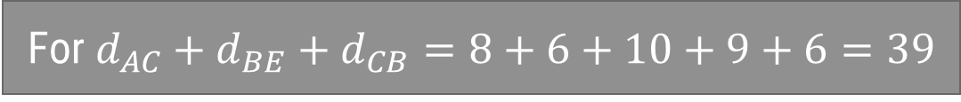

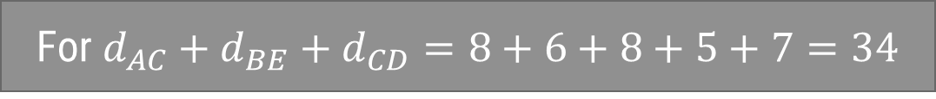

TSP using Branch & Bound
 | A | B | C | D | E
A | -- | 10 | 8 | 9 | 7
B | 10 | -- | 10 | 5 | 6
C | 8 | 10 | -- | 8 | 9
D | 9 | 5 | 8 | -- | 6
E | 7 | 6 | 9 | 6 | --
$$d_{AB}$$
$$d_{AE}$$
$$d_{AC}$$
$$d_{AD}$$
35
32
34
31
$$d_{BA}$$
$$d_{BD}$$
$$d_{BC}$$
36
36
34
$$d_{BA}$$
$$d_{BD}$$
$$d_{BE}$$
37
33
33
For $d_{AC}+d_{BE}+d_{CB}=8+6+10+9+6=39$
$$d_{CB}$$
$$d_{CE}$$
$$d_{CB}$$
$$d_{CD}$$
For $d_{AC}+d_{BE}+d_{CD}=8+6+8+5+7=34$
36
37
39
34
The optimal route is A – C – D – B – E – A with total cost = 34

Slide 24
Difference between Branch & Bound and Backtracking
Branch & Bound Backtracking
Branch-and-Bound is used to solve optimization problems.
Backtracking is a general algorithm for finding all or some solutions to the computational problems.
A branch-and-bound algorithm consists of a systematic enumeration of candidate solutions. The set of candidate solutions is thought of as forming a rooted tree, the algorithm explores branches of this tree, which represent the subsets of the solution set.
It incrementally builds candidates to the solutions, and backtracks as soon as it determines that the candidate cannot possibly be completed to a valid solution.
Branch-and-Bound traverse the tree in any manner, DFS or BFS.
It traverses the state space tree by DFS(Depth First Search) manner.

Slide 25
Difference between Branch & Bound and Backtracking
Branch & Bound Backtracking
Before enumerating the candidate solutions of a branch, the branch is checked against upper and lower estimated bounds on the optimal solution and is discarded if it cannot produce a better solution than the best one found so far by the algorithm.
It is an algorithmic-technique for solving problems using recursive approach by trying to build a solution incrementally, one piece at a time, removing those solutions that fail to satisfy the constraints of the problem at any point of time.
Branch-and-Bound involves a bounding function.
Backtracking involves feasibility function.
Branch-and-Bound is less efficient.
Backtracking is more efficient.

Slide 26
MiniMax principle

Slide 27
Minimax – Example
Given a given game tree, the optimal strategy can be determined from the minimax value of each node.
MAX prefers to move to a state of maximum value, whereas MIN prefers a state of minimum value.
MAX (player)
3
MIN (opponent)
3
2
2
3
12
8
2
4
6
14
5
2

Slide 28
Minimax - Introduction
The minimax value of a node is the utility (for MAX) of being in the corresponding state, assuming that both players play optimally from there to the end of the game.
The key to the Minimax algorithm is a back and forth between the two players, where the player whose "turn it is" desires to select the move with the maximum score.
In turn, the scores for each of the available moves are determined by the opposing player deciding which of its available moves has the minimum score.
It uses a simple recursive computation of the minimax values of each successor state.
The recursion proceeds all the way down to the leaves of the tree, and then the minimax values are backed up through the tree as the recursion unwinds.

Slide 29
Minimax Algorithm in Game Theory – Tic Tac Toe
Tic-tac-toe is a paper-and-pencil game for two players, X and O, who take turns marking the spaces in a 3×3 grid.
The player who succeeds in placing three of their marks in a horizontal, vertical, or diagonal row wins the game.
Minimax is a recursive algorithm which is used to choose an optimal move for a player assuming that the opponent is also playing optimally.
As its name suggests, its goal is to minimize the maximum loss (minimize the worst case scenario).
To check whether or not the current move is better than the best move we take the help of minimax() function which will consider all the possible ways the game can go and returns the best value for that move, assuming the opponent also plays optimally.

Slide 30
X | X | O
X | O
 | O
Human
Max
WIN
X | X | O
X | O | X
 | O
X | X | O
X | O
X | O
X | X | O
X | O
 | O | X
Computer
Min
WIN
WIN
X | X | O
X | O | X
O | O
X | X | O
X | O | X
 | O | O
X | X | O
X | O
O | O | X
X | X | O
X | O | O
 | O | X
Human
Max
WIN
WIN
X | X | O
X | O | X
X | O | O
X | X | O
X | O | O
X | O | X
Computer
Min

Slide 31
Thank You!

